Slide 1

Shoppie
- A desktop shopping application.
By
137 - Karthik Reddy
168 - Shitij Reddy
172 - Siddharth

Slide 2
Description
Shoppie is a desktop based E-Commerce application which provides the an intuitive and easy to use platform for the buyers and sellers.
Shoppie is different from the already existing E-Commerce applications. With this application it is possible for both the buyers and sellers to buy/sell products.
Customers can give rating to the products listed by the merchants and to the merchants themselves based on the quality of products being sold.
Using this application, shops can provide a portal where their customers can enjoy easy shopping from anywhere, It helps buying the products in the shop anywhere by using a desktop application. Thus the customer will get the service of online shopping and home delivery from his favorite shop.
For newly started businesses, this application becomes very helpful by providing them with customers.

Slide 3
Abstract
The project objective is to provide a portal for buying and selling. Shoppie is a desktop based application which provides shopping services. It can have various brands, customers and merchants.
This application will provide an interactive and ease of use platform for users and merchants to buy and sell products at the comfort of home.
It would make searching, viewing and selection of a product easier. It contains a sophisticated search engine for user's to search for products specific to their needs. The search engine provides an easy and convenient way to search for products.
Considering this pandemic time, it would be a helping tool for the ones who want to shop from their home.

Slide 4
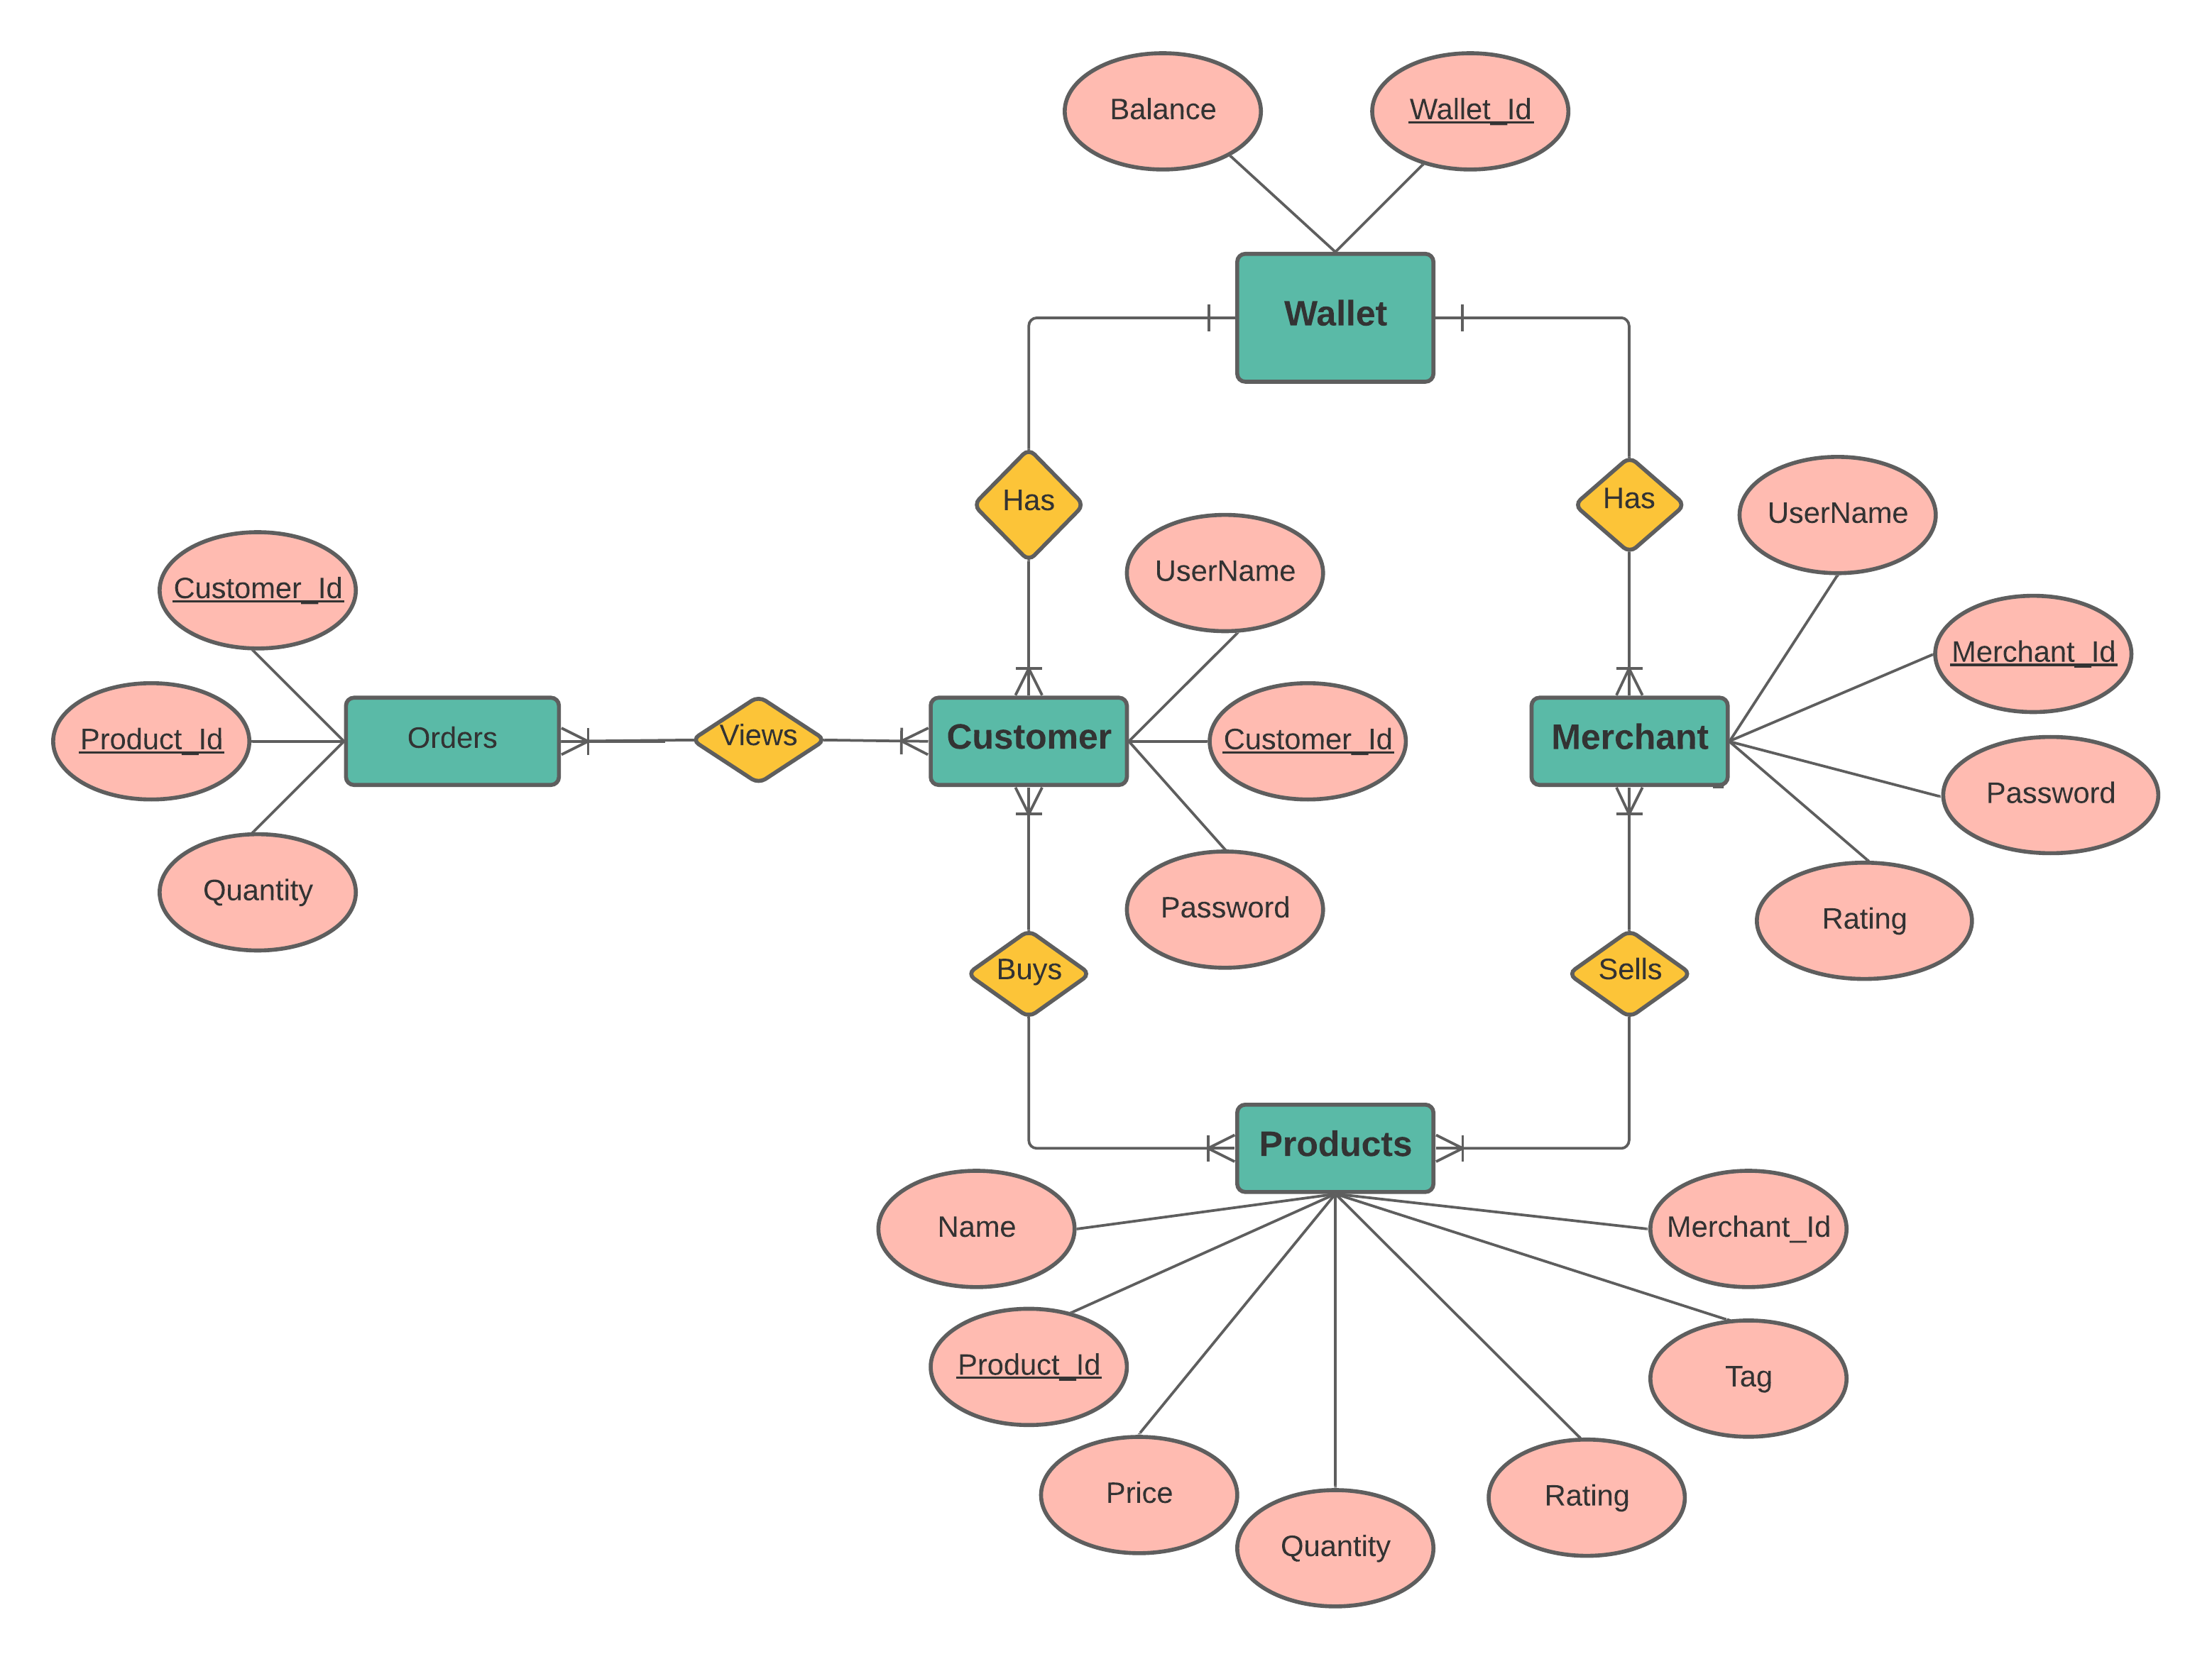
Er-Diagram

